Slide 1

Version Control

Slide 2
Joe Appleton (Your Lecturer)
10 Years commercial software experience
Currently lecturing at Southampton Solent University

Slide 3
Overview
Why we need version control
The importance version control in the software and web development workplaces
Cover the development of Version control
Explain how the version control works
Version control and working collectively
Command line or graphic user interfaces (GUI)

Slide 4
What we will cover
Downloading and Setting up Git
Using the command line to interact with Git locally
Initialise a Git repository
Staging
Commits
Checkouts
Branches

Slide 5
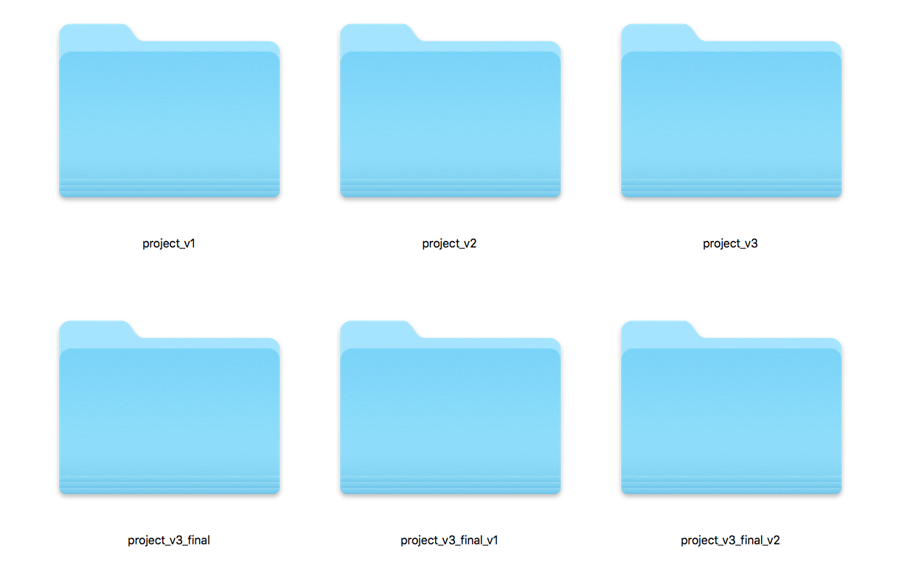
Notes:
Why version control? When you working on a project you might say different versions with multiple duplicate folders or documents without a system of documenting your changes things can get out of hand and work can be lost or overwritten

Slide 6

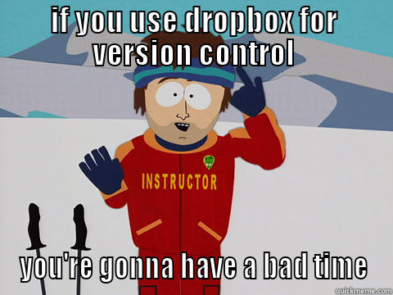
Notes:
Again people may use cloud storage for saving their work and controlling different versions this is good that certain types of projects but if you’re working collaboratively or on complicated projects you will run into issues and also you still do not have any way of organising or recording changes or be able to see an overall map of your project

Slide 7
Digital Designer
“Involved with Open Source projects (and have the GitHub profile to prove it)”
Notes:
All jobs in a professional coding, Scripting and development environments Will require a knowledge Version control – and git is a popular version control which employers require this skill for their employees.

Slide 8
Front End Web Developer
“Send us the link to your GitHub”
Notes:
All jobs in a professional coding, Scripting and development environments Will require a knowledge Version control – and git is a popular version control which employers require this skill for their employees.

Slide 9
PHP Developer
“Experience of version control software, such as Git”
Notes:
All jobs in a professional coding, Scripting and development environments Will require a knowledge Version control – and git is a popular version control which employers require this skill for their employees.

Slide 10
Ruby on Rails Developer
“Github and Git will be second nature to you”
Notes:
All jobs in a professional coding, Scripting and development environments Will require a knowledge Version control – and git is a popular version control which employers require this skill for their employees.

Slide 11

My response to: “I am old school, Git & GitHub are fads”
Notes:
There are so many technologies and and methods in front-end web design and development environments that it is very hard to keep up-to-date, also how long will these technologies be around, and do you need to invest time learning them, only to find they are redundant in a short space of time.

Slide 12

UNIX 1969
Notes:
We need to go back to 1969 with the development of the UNIX Computer system and the beginning of modern computing.

Slide 13

1972
Notes:
Okay let's no-fault to 1972 to find out the origins of version control in computing

Slide 14
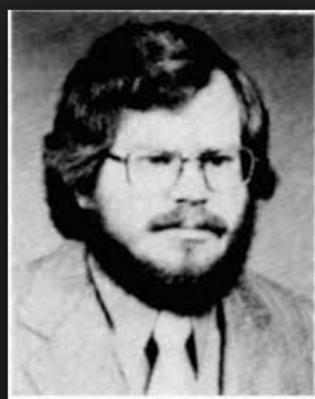
Source Code Control System (SCCS)
The source code control system
Issue No.04 - Dec. (1975 vol.1)
pp: 364-370
Marc J. Rochkind , Bell Laboratories, Murray Hill, N. J. 07974
ABSTRACT
The Source Code Control System (SCCS) is a software tool designed to help programming projects control changes to source code. It provides facilities for storing, updating, and retrieving all versions of modules, for controlling updating privileges, for identifying load modules by version number, and for recording who made each software change, when and where it was made, and why. This paper discusses the SCCS approach to source code control, shows how it is used and explains how it is implemented.
http://www.computer.org/csdl/trans/ts/1975/04/06312866-abs.html
Notes:
Marc Rochkind develops source code control system (SCCS) in 1971 and publishes a paper on his work in 1975. What is outlined in the abstract is exactly what defines version control over 40 years later. So version control is not exactly the new kid on the block

Slide 15
The Source Code Control System (SCCS) is a software tool designed to help programming projects control changes to source code.
It provides facilities for storing, updating, and retrieving all versions of modules, for controlling updating privileges, for identifying load modules by version number, and for recording who made each software change, when and where it was made, and why.

Slide 16

1991
Notes:
Based on UNIX, Linix appears in 1991

Slide 17

1998
Notes:
The LINUX development team uses the then the Source version contro: bit keeper

Slide 18

Larry McVoy
Notes:
This is developed by Larry McVoy

Slide 19
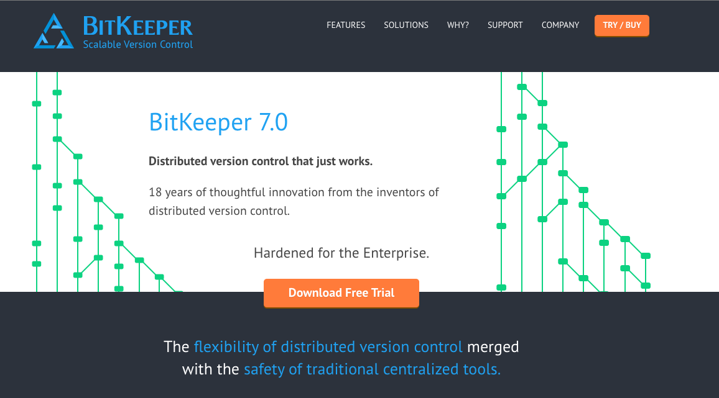
Notes:
Bit keeper is still around today although it's no longer open source and enterprise only
http://www.bitkeeper.com/

Slide 20

Notes:
Not quite Open Source - http://static.lwn.net/1999/features/BitKeeper.php3

Slide 21
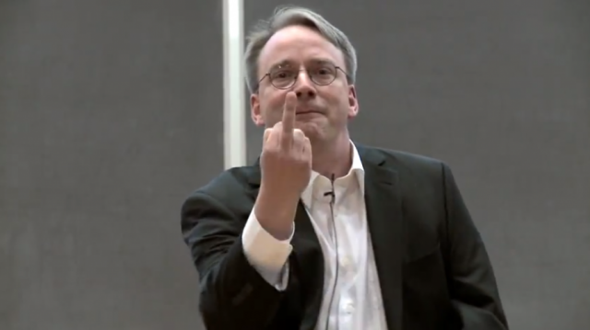
Linus Torvalds

Slide 22
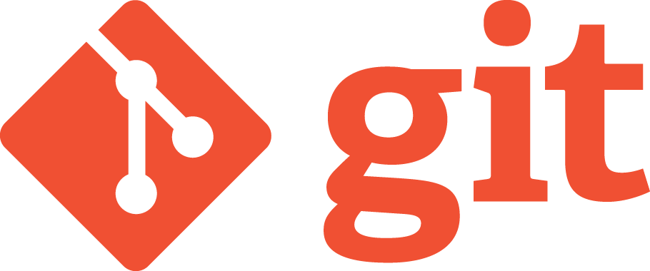
2005

Slide 23
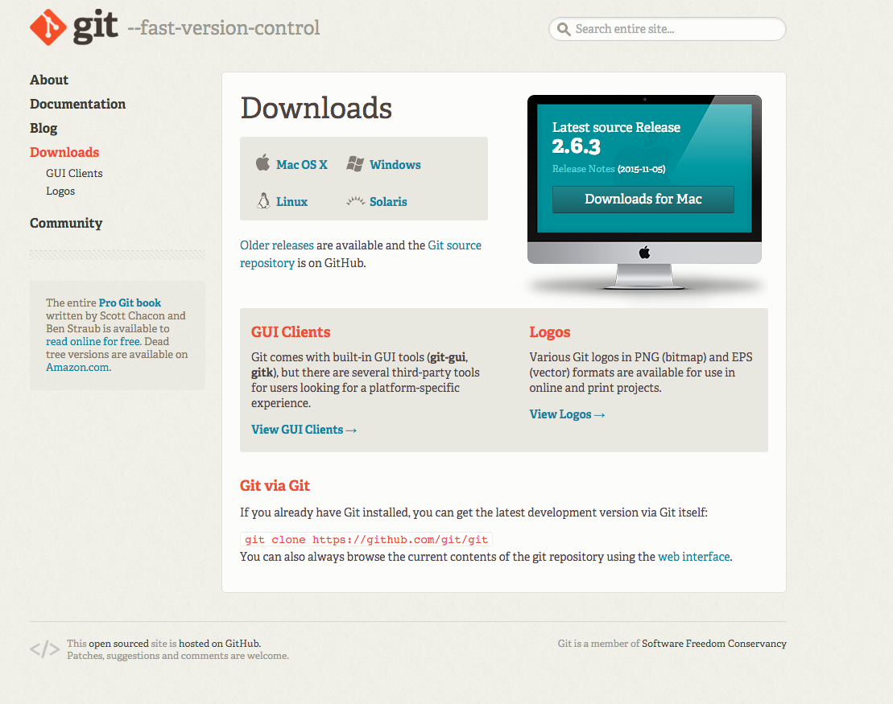
https://git-scm.com/downloads

Slide 24
https://git-scm.com/downloads

Slide 25


Slide 26
master
Current HEAD Position
Master branch:initial commit

Slide 27
master
Current HEAD Position
Master branch:2nd commit

Slide 28
master
Current HEAD Position
Master branch:3rd commit

Slide 29
master
Current HEAD Position
Master branch:4th commit

Slide 30
master
Detached HEAD State
Master branch:checkout

Slide 31


Slide 32
master
Current HEAD Position
feature
Feature branch:1st commit

Slide 33
master
Current HEAD Position
feature
Feature branch:2nd commit

Slide 34
master
Current HEAD Position
feature
Merge feature to master

Slide 35
master
Current HEAD Position
feature
Merge feature to master

Slide 36
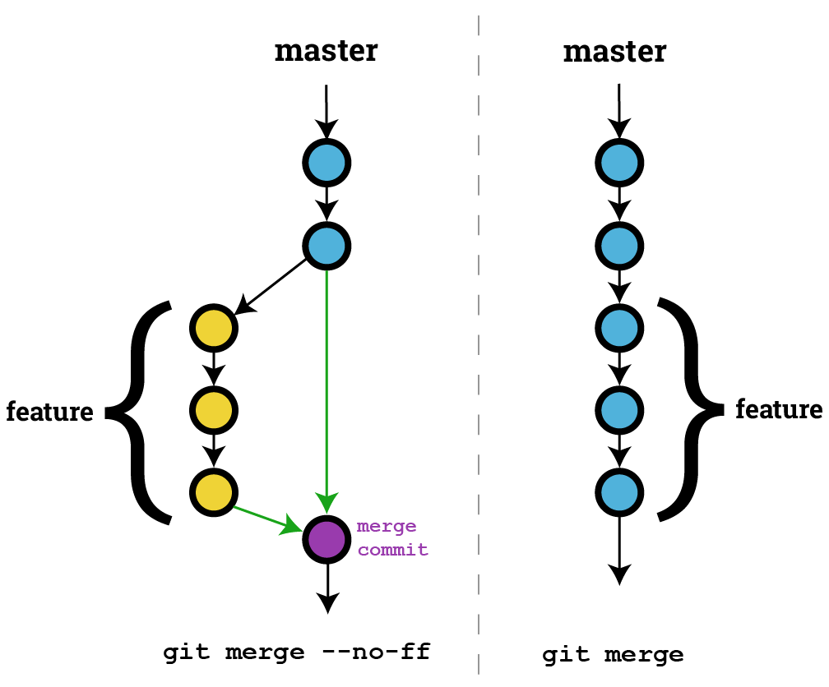

Slide 37
master
feature
Time travel

Slide 38
master
feature
Time travel

Slide 39
master
feature
Time travel

Slide 40
master
feature
Time travel

Slide 41
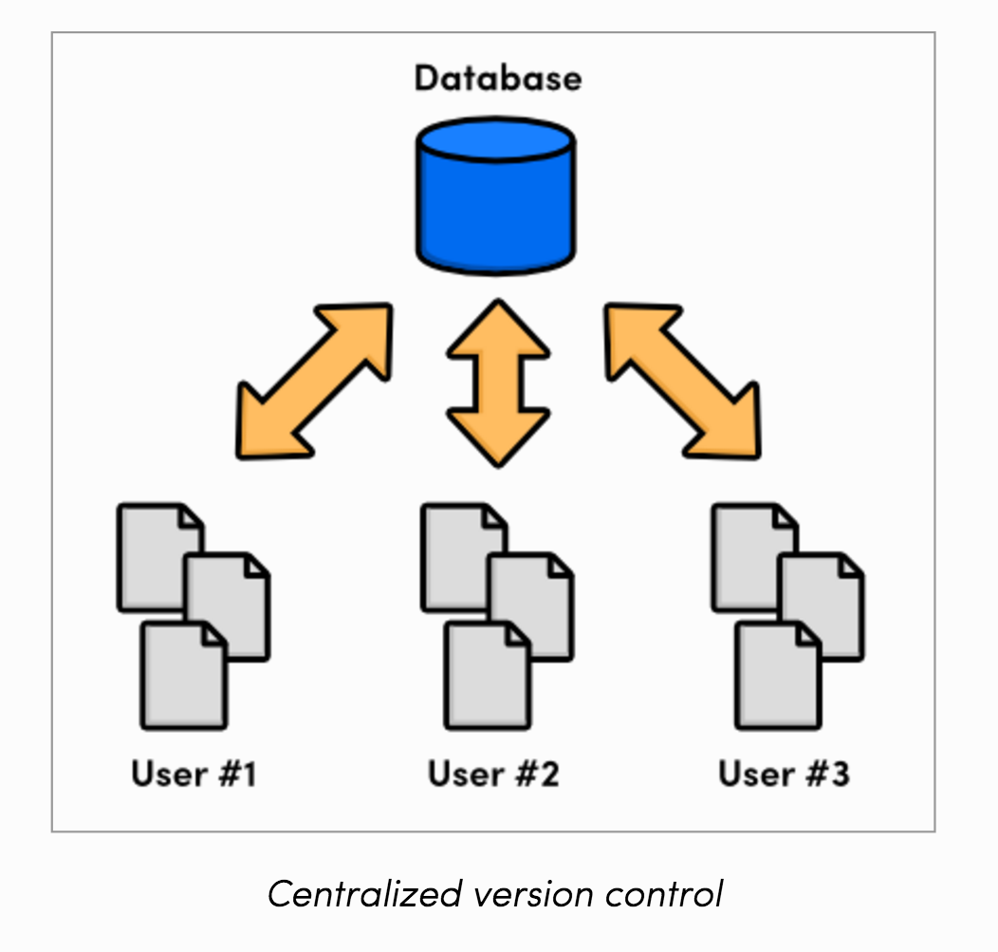

Slide 42
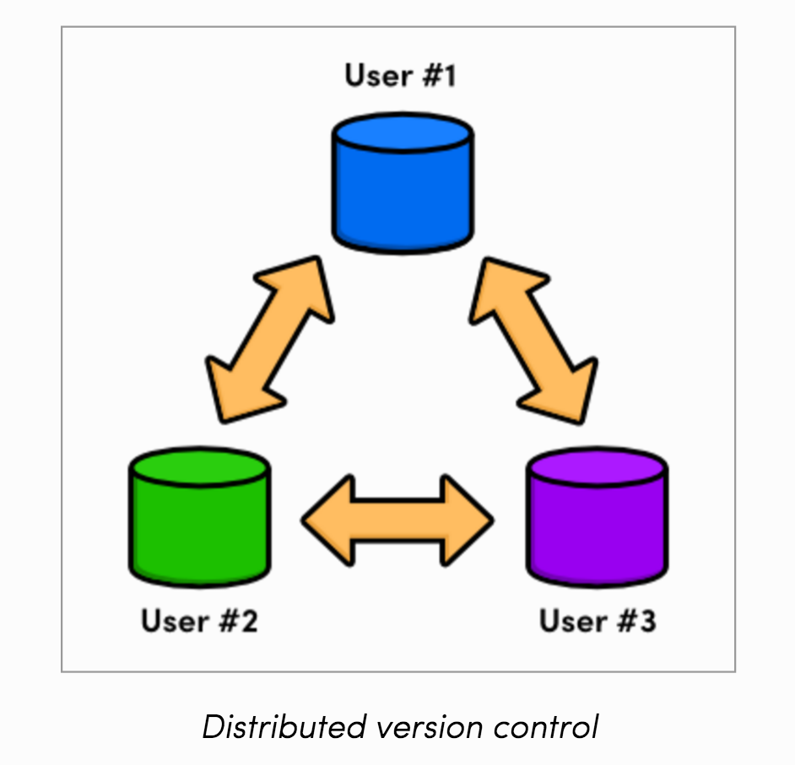

Slide 43



Slide 44
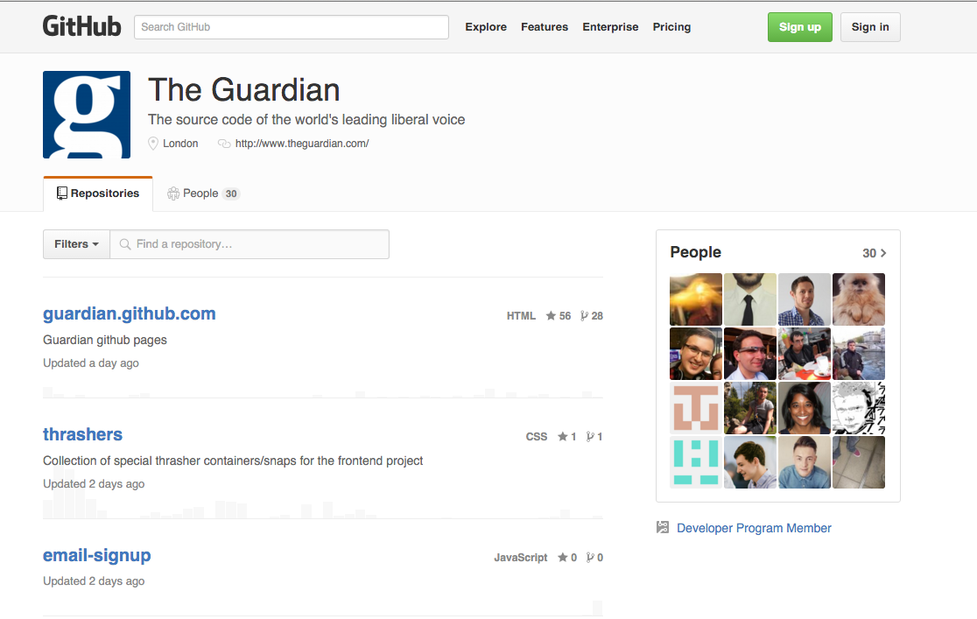
https://github.com/guardian/frontend

Slide 45
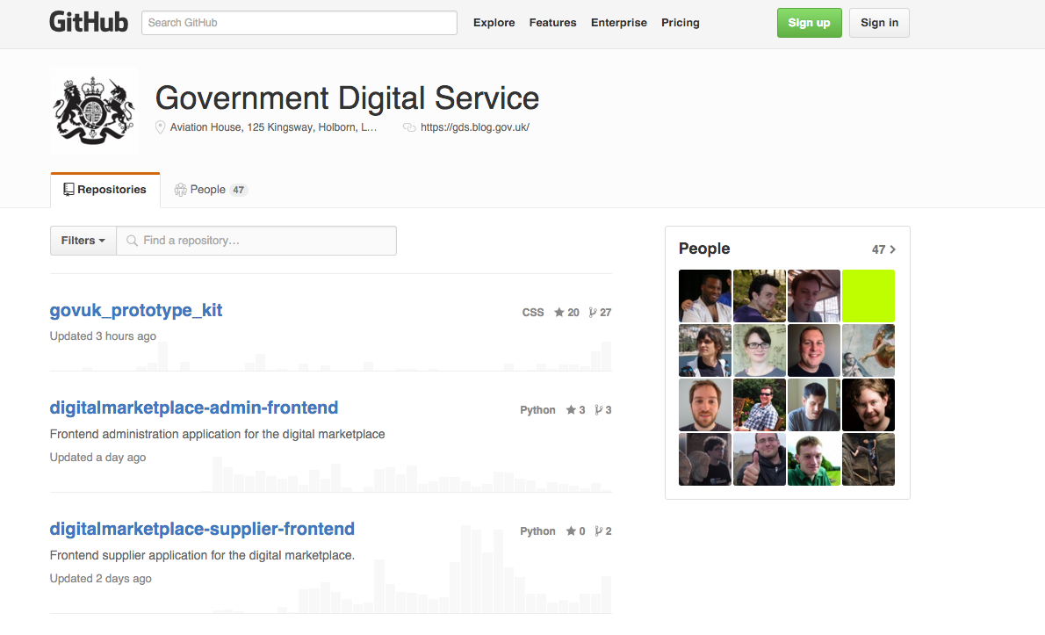
https://github.com/alphagov/govuk_frontend_toolkit

Slide 46
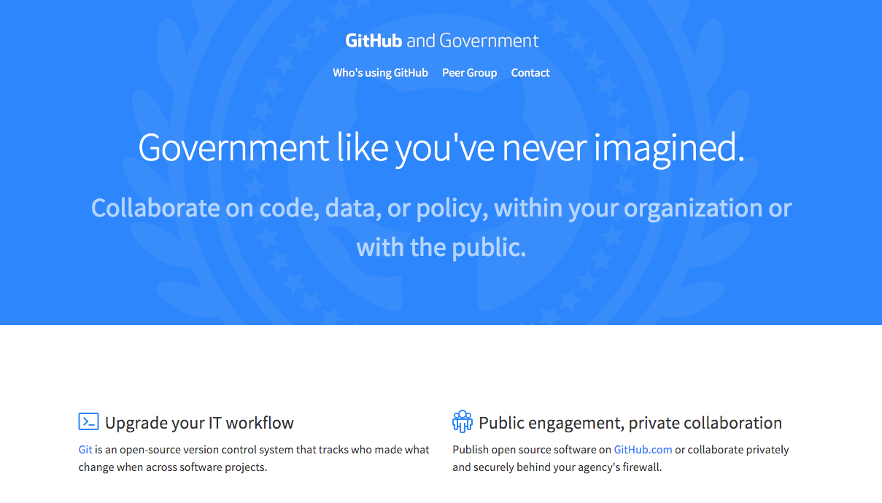
https://government.github.com/

Slide 47
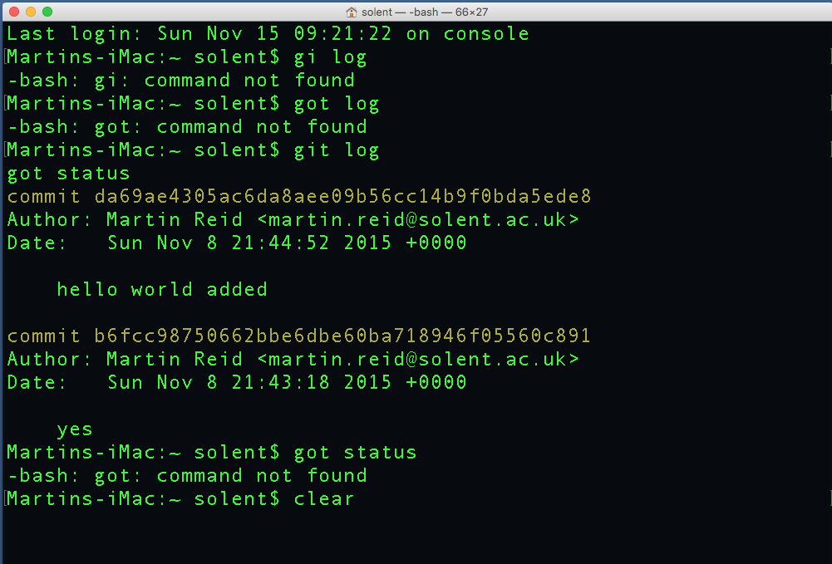
Command Line or GUI?

Slide 48
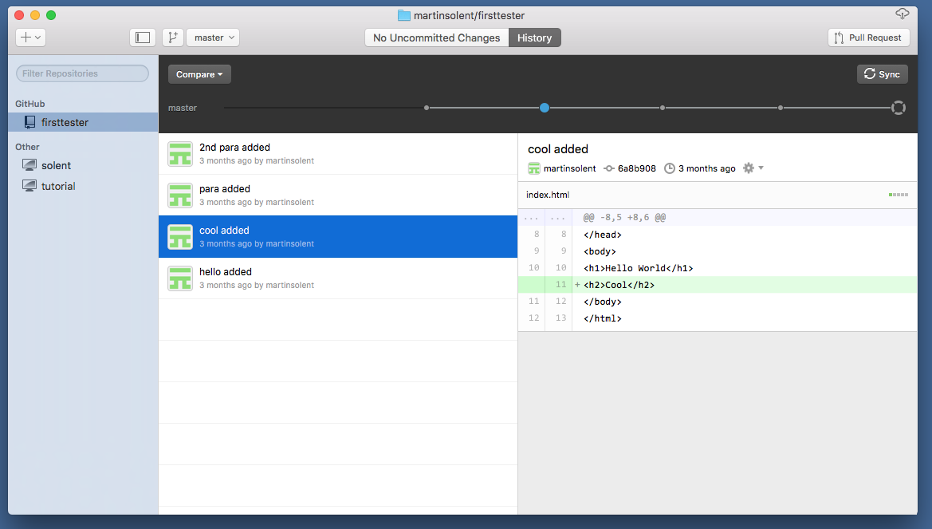
Command Line or GUI?

Slide 49
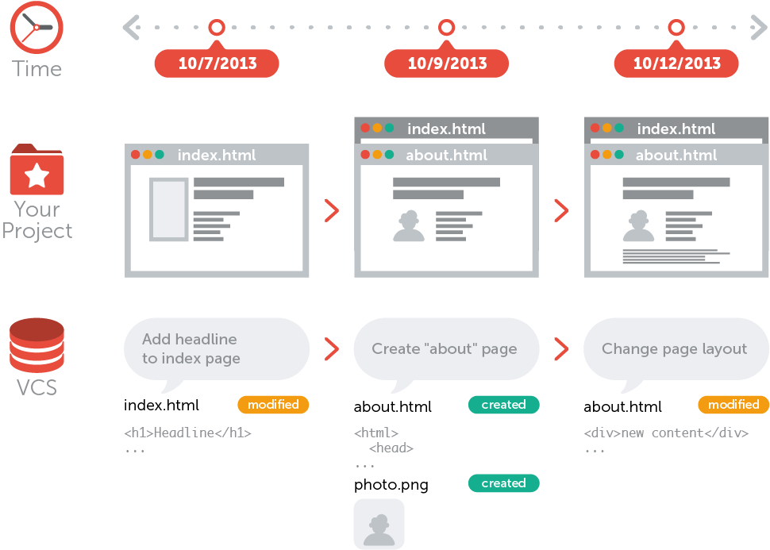
https://www.git-tower.com/learn/git/ebook/command-line/remote-repositories/introduction

Slide 50
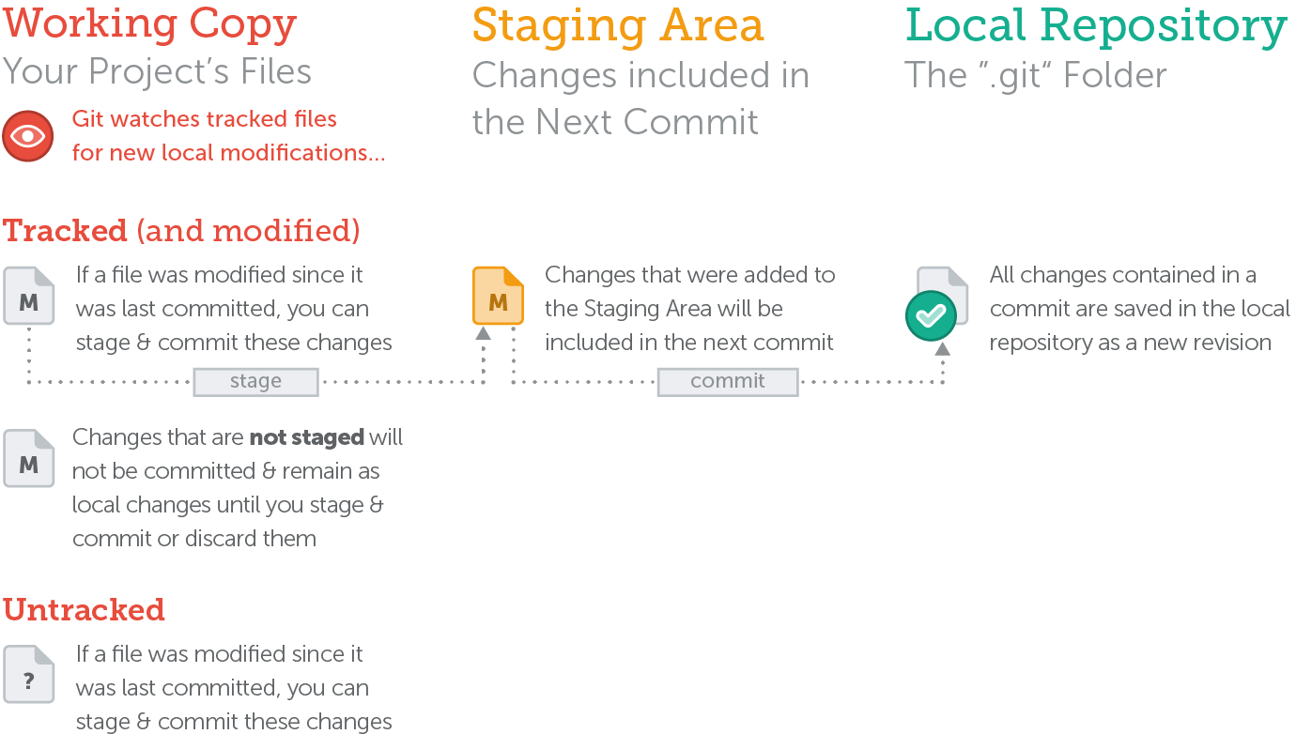
https://www.git-tower.com/learn/git/ebook/command-line/remote-repositories/introduction

Slide 51
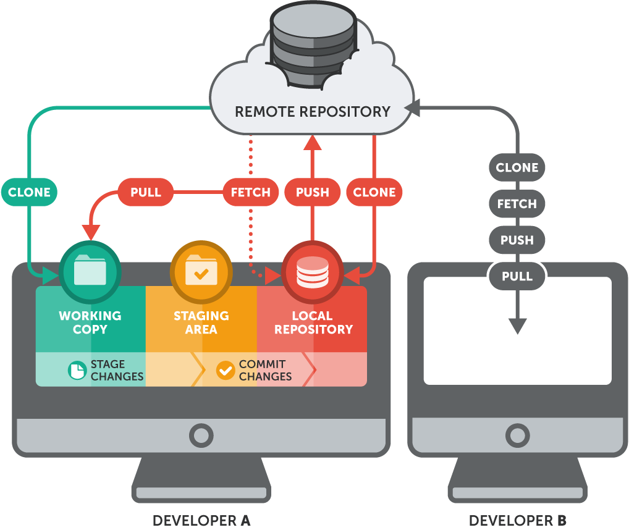
https://www.git-tower.com/learn/git/ebook/command-line/remote-repositories/introduction

Slide 52
Git Glossary
Repository (Repo) – A kind of database where your project is stored. There are two kind of repositories: local and remote.
Branch – This is the “track” your project runs on. Your can have a number of branches, as a default you start with a Master branch.
Staging Area - This is where you gather all your files to be Committed.
Add - This is how you add files to the staging area.

Slide 53
Git Glossary
Commit - This captures an instance of your project.
Head State – Current position of your project (tip of a the project or Branch)
Checkout – This is how you define an instance in your project.
Detached Head State – This is how a Checkout is described. You would then create a new (“feature”) branch.
Status – Lets you now the current status of your Repository.

Slide 54
Git Glossary
Log - Shows a log of all Commits
Merge – Merges branches together
Diff – Compare what has changed between Commits
Tracked – Files Git “watches”
Untracked - Files you have not told Git to track

Slide 55
Git online Tutorials
Ry’s Git Tutorial http://rypress.com/tutorials/git/the-basics
Learn Version Control with Git - A step-by-step course for the complete beginner: https://www.git-tower.com/learn/git/ebook/command-line/basics/why-use-version-control#start
Git Cheat Sheet (Tower):
http://www.git-tower.com/blog/git-cheat-sheet/
The entire Pro Git book, written by Scott Chacon and Ben Straub and published by Apress, is available here:
https://git-scm.com/book/en/v2
Atlassian - Getting Git Right:
https://www.atlassian.com/git/tutorials/setting-up-a-repository
GitHub Classroom Guide
https://education.github.com/guide
Solent Screencast Tutorials – Git:
https://www.youtube.com/playlist?list=PL-C4a9Qw2_Y73x40s23R8u8RZoUHt9IyL

